Slide 1
Age and gender detection
By : Yousif mirza
& manahil mirza & Zahra & rita
Supervisor : dr . firas

Slide 2
contents
1.Inroduction
2. What are the uses of age and gender prediction?
3. What are the advantages of age and gender prediction?
4. Conclusion

Slide 3
introduction
What is age and gender detection?
Age and gender detection has numerous applications in different domains, such as security systems, entertainment, and social media analysis. In security systems, the application can be used to identify potential threats by analyzing the age and gender of people in the vicinity.
we had used Deep Learning to accurately identify the gender and age of a person from a single image of a face. The predicted gender may be one of ‘Male’ and ‘Female’, and the predicted age may be one of the following ranges- (0 – 2), (4 – 6), (8 – 12), (15 – 20), (25 – 32), (38 – 43), (48 – 53), (60 – 100) (8 nodes in the final softmax layer). It is very difficult to accurately guess an exact age from a single image because of factors like makeup, lighting, obstructions, and facial expressions.
Notes:
Potential threats:privacy,unfairness

Slide 4
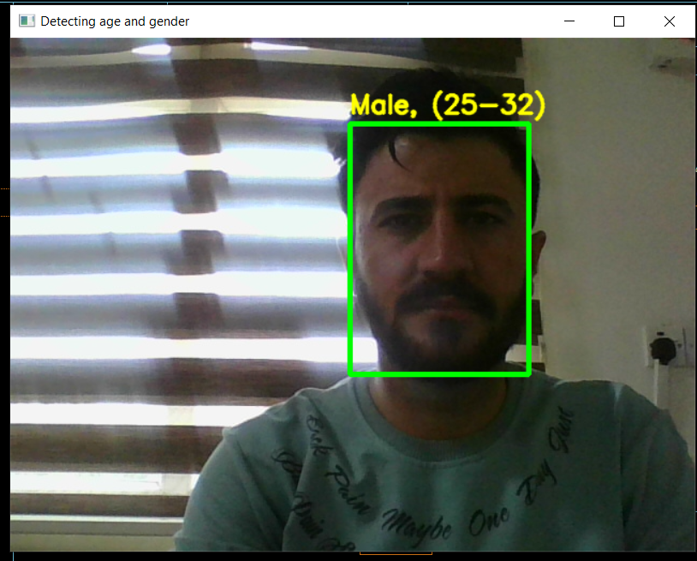
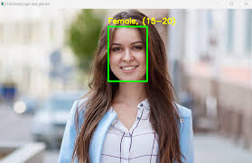
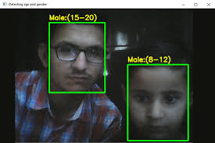
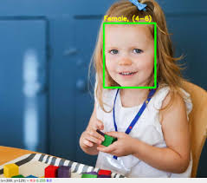

Slide 5
What are the uses of age and gender prediction?
Age and gender prediction finds applications in various fields, including targeted advertising, market research, customer segmentation, and personalized user experiences. It helps businesses tailor their products and services to specific demographics and

Slide 6
What are the advantages of age and gender prediction?
With the right age and gender data, you can market more to your customers and stop spending to reach those who are not interested. In short, gender and age detection will make your brand stand out from your competitors and enable you to get more customers.
Age and gender detection are the determination of the age and gender of the people in an image or video. This process allows essential data to be obtained and used very effectively in business development processes.

Slide 7
conclusion
Age and gender detection tech is getting better, but it still makes mistakes. We need to be careful about privacy and fairness. Even though they can be useful, we have to make sure we use them responsibly and treat everyone fairly

